Slide 1

MAHARISHI UNIVERSITY OF MANAGMENT
Web Application Programming Project
Title : Share Ride Web Application
Department : Computer Science
Date : 11/21/2019

Slide 2
Group Members
1. Dawit Anbessie : 610521 2. Yared Beyene : 110466 3. Mulusew Kassa : 610480 4. Tesfai Gebrekidan : 110464

Slide 3
Introduction
Transportation plays a vital roll in our day to day activates
With the help of technology we can make some difference in our way of transportation
The ride share app provides a suitable a way to connect customers with drivers.
customers can search and reserve a sit for a trip
On the other hand drivers can post a drive
The application displays the available drive for a specified date and time

Slide 4
Objective
The main objective of this project is to provide a convenient way of connecting Drivers and customers for transportation sevice

Slide 5
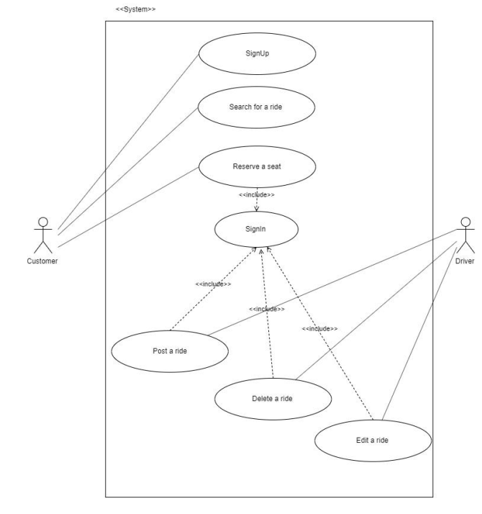
Use case diagram

Slide 6
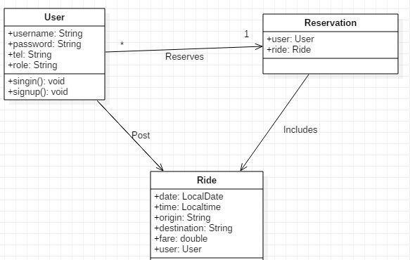
Application Class Diagram

Slide 7
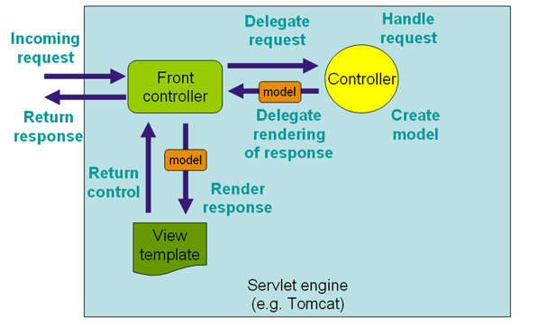
Design Pattern
We used Model 2 architecture to design our web application

Slide 8
OO Analysis ,Design and Programming Principles
In order to implement this application
WE identified different interacting objects and their relationships.
user, ride and reservation objects
We applied java servlet classes as controller ,java classes for Model(POJO ) and Java sever pages for view

Slide 9
Implementation and Result
This application enables
users to see available drives and details about a particular drive
Users to sign in and sign up to reserve a drive
Drivers to sign in ,sign up and post a drive

Slide 10
Conclusion and Recommendation
This application enables users and drivers to communicate easily for a given trip at specified date and time.
This application needs more enhancement to be agile software.
In the future we will make this application more interactive and responsive.

